Slide 1

What Mr. Spock would possibly say about modern unit testing: pragmatic and emotional overview

Slide 2
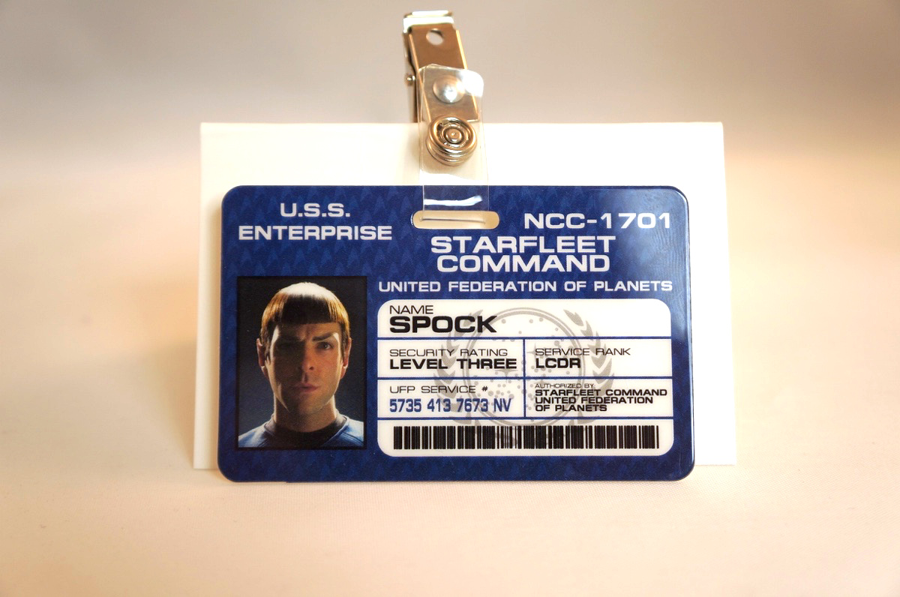
About me
Yaroslav Yermilov
Senior Software Engineer
EPAM Systems
Work on Big Data project
But responsible for test automation for
the last 2 years
Out of office is a big Groovy ecosystem fan
So the topic choice is obvious

Slide 3
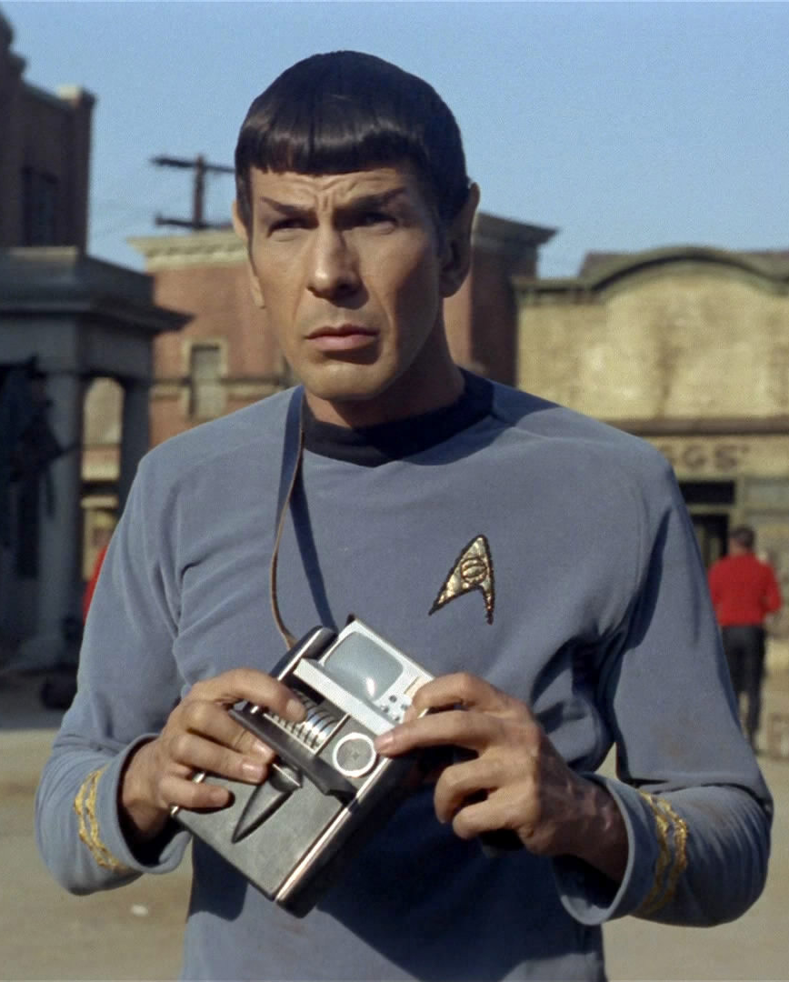
Questions Mr. Spock have
What’s about modern unit testing?
Why try Spock?
How to start with Spock?
Advanced and hidden features
What JUnit/TestNG/others offers instead?
Why use Spock?
Why do not use Spock?
When use Spock?

Slide 4




Acknowledgments and disclaimer

Slide 5

Better to test before going to production

Slide 6

JUnit?

Slide 7

JUnit 5?

Slide 8

JUnit 3?

Slide 9

TestNG?

Slide 10

Unit testing framework on steroids?
Hamcrest
AssertJ
Google Truth
Mockito
PowerMock
JMockit

Slide 11
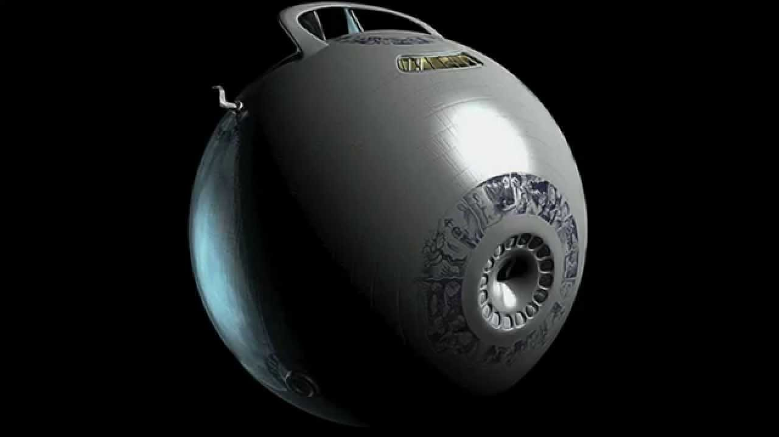
Something odd?
Cucumber
J8Spec JGiven

Slide 12

Spock?

Slide 13

Nothing?

Slide 14
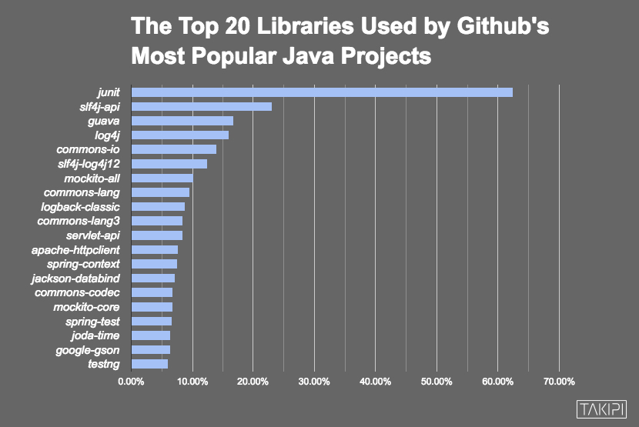

Slide 15

Automated testing
is a great concept

Slide 16

But have you ever felt like it’s frozen for the years?

Slide 17
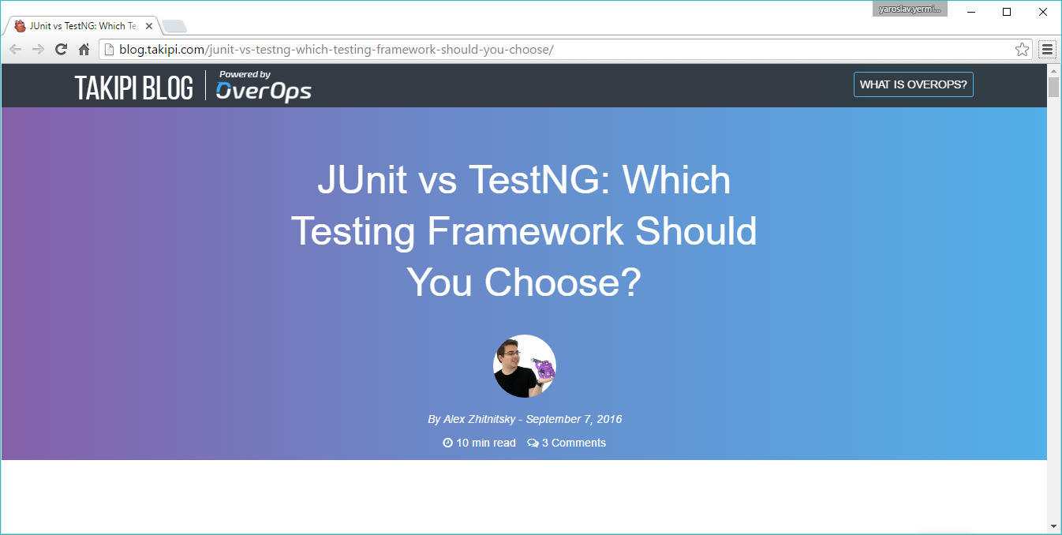

Slide 18
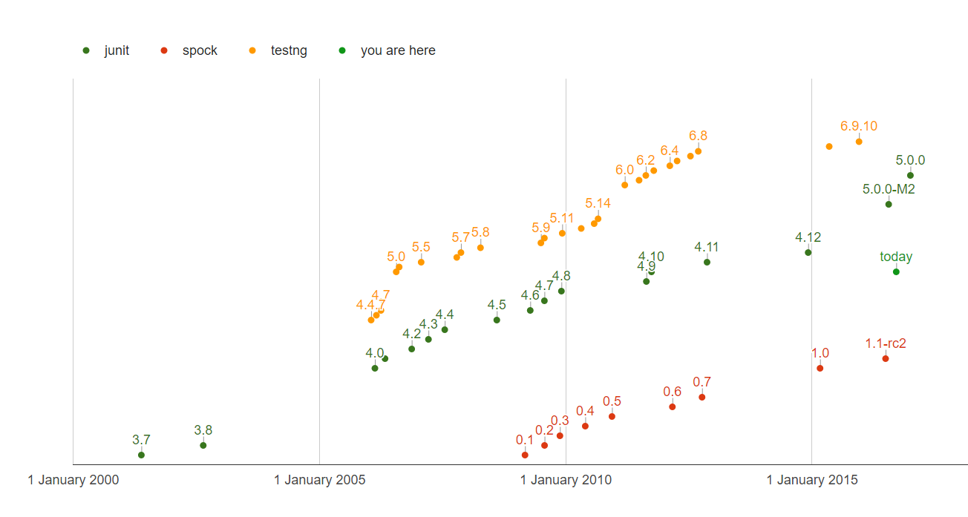
QUIZ: How many test framework releases we had since 2013?

Slide 19
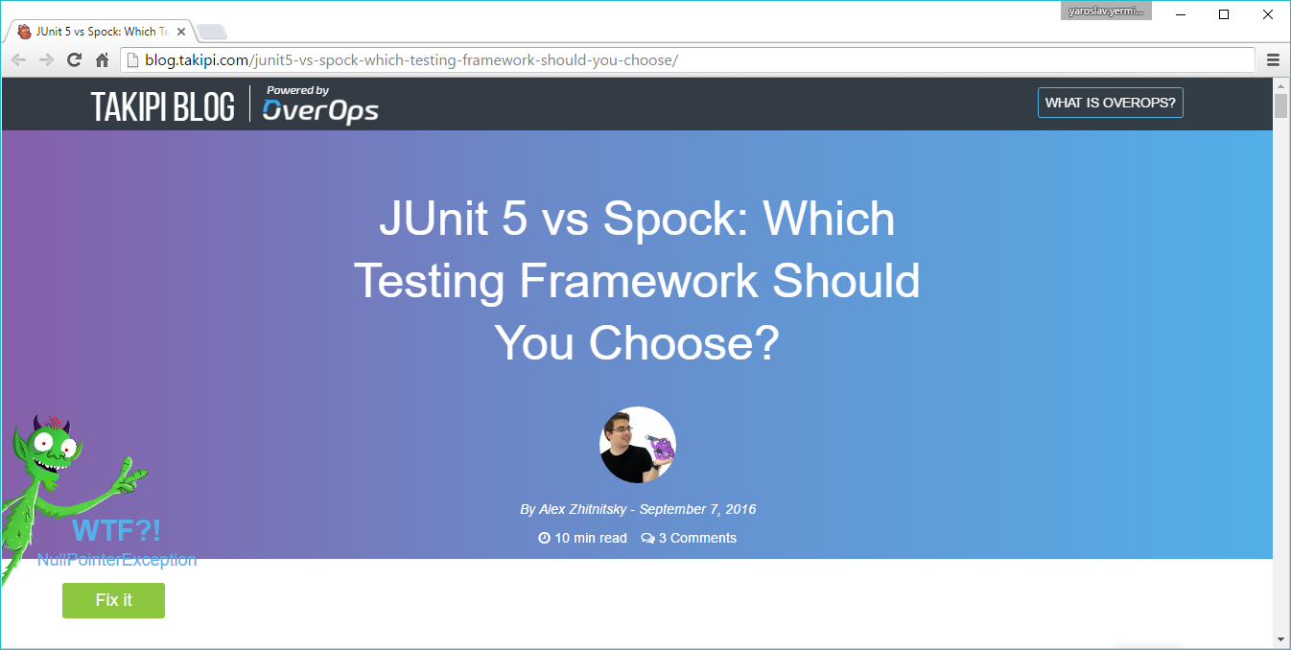

Slide 20

So why don’t try Spock?

Slide 21

Spock is the next generation testing framework

Slide 22

Spock is Enterprise ready

Slide 23
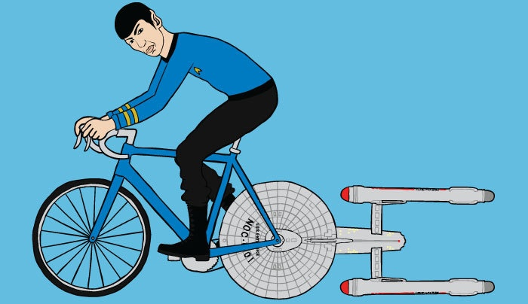
Let’s go!
https://github.com/yermilov/spock-talk

Slide 24

Episode I: Every journey starts somewhere

Slide 25
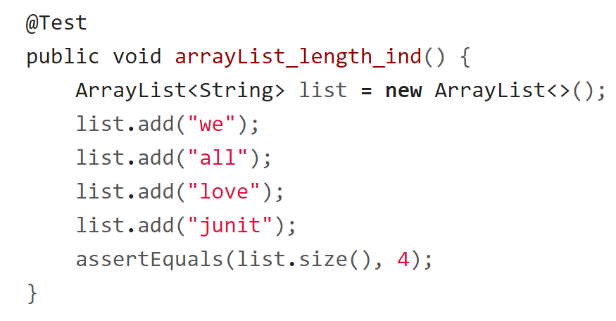
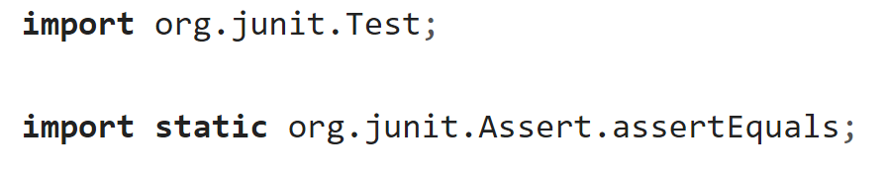
Episode I: Every journey starts somewhere

Slide 26
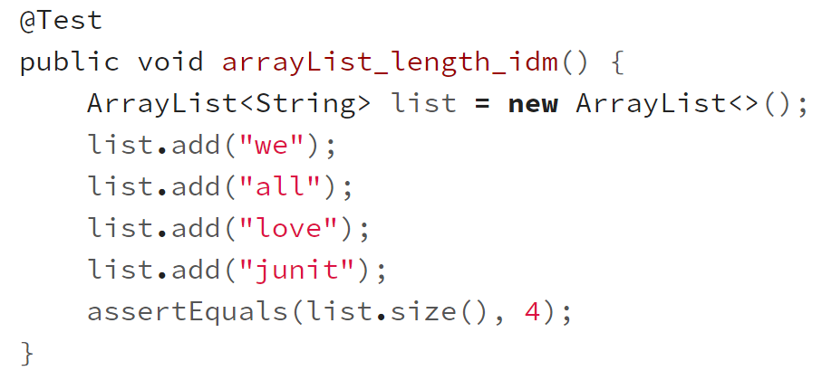
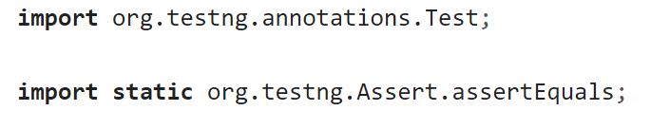
Episode I: Every journey starts somewhere

Slide 27
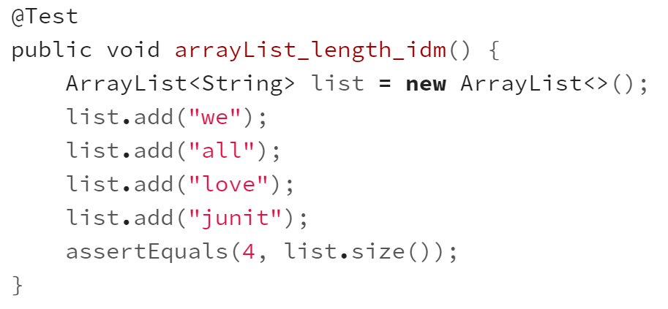
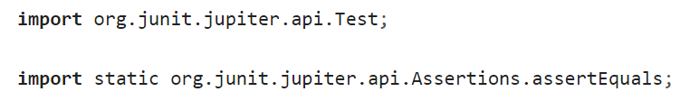
Episode I: Every journey starts somewhere

Slide 28
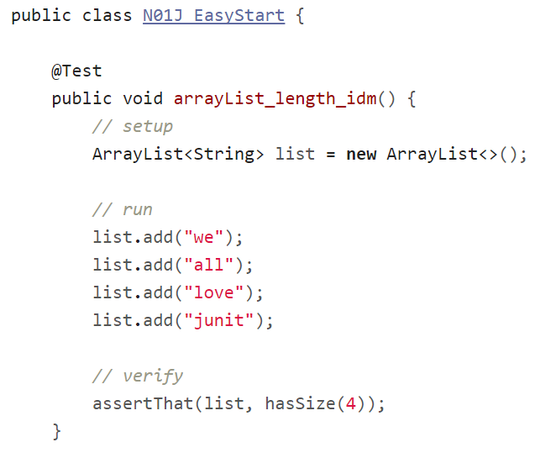
Episode I: Every journey starts somewhere

Slide 29
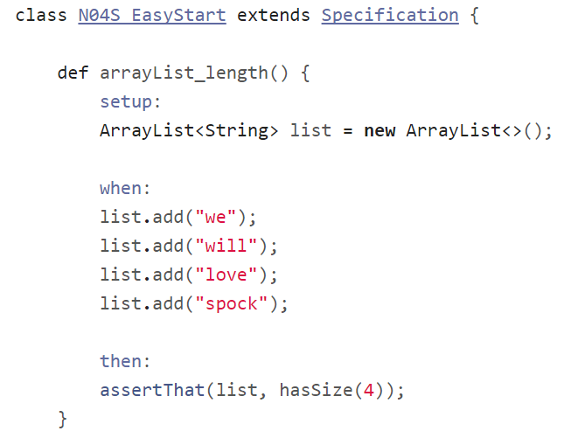
Episode I: Every journey starts somewhere

Slide 30
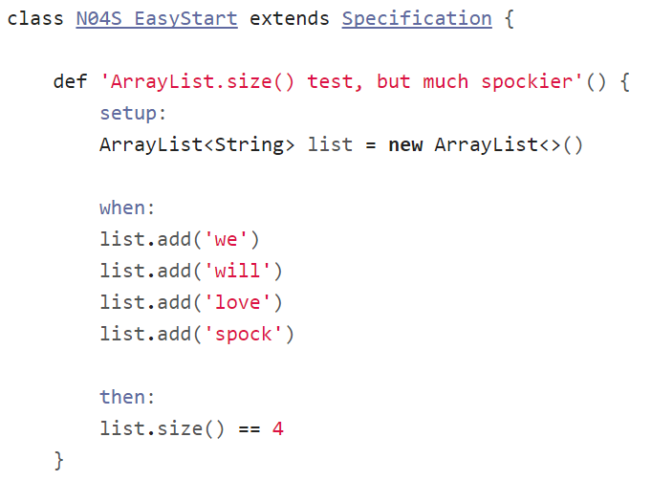
Episode I: Every journey starts somewhere

Slide 31
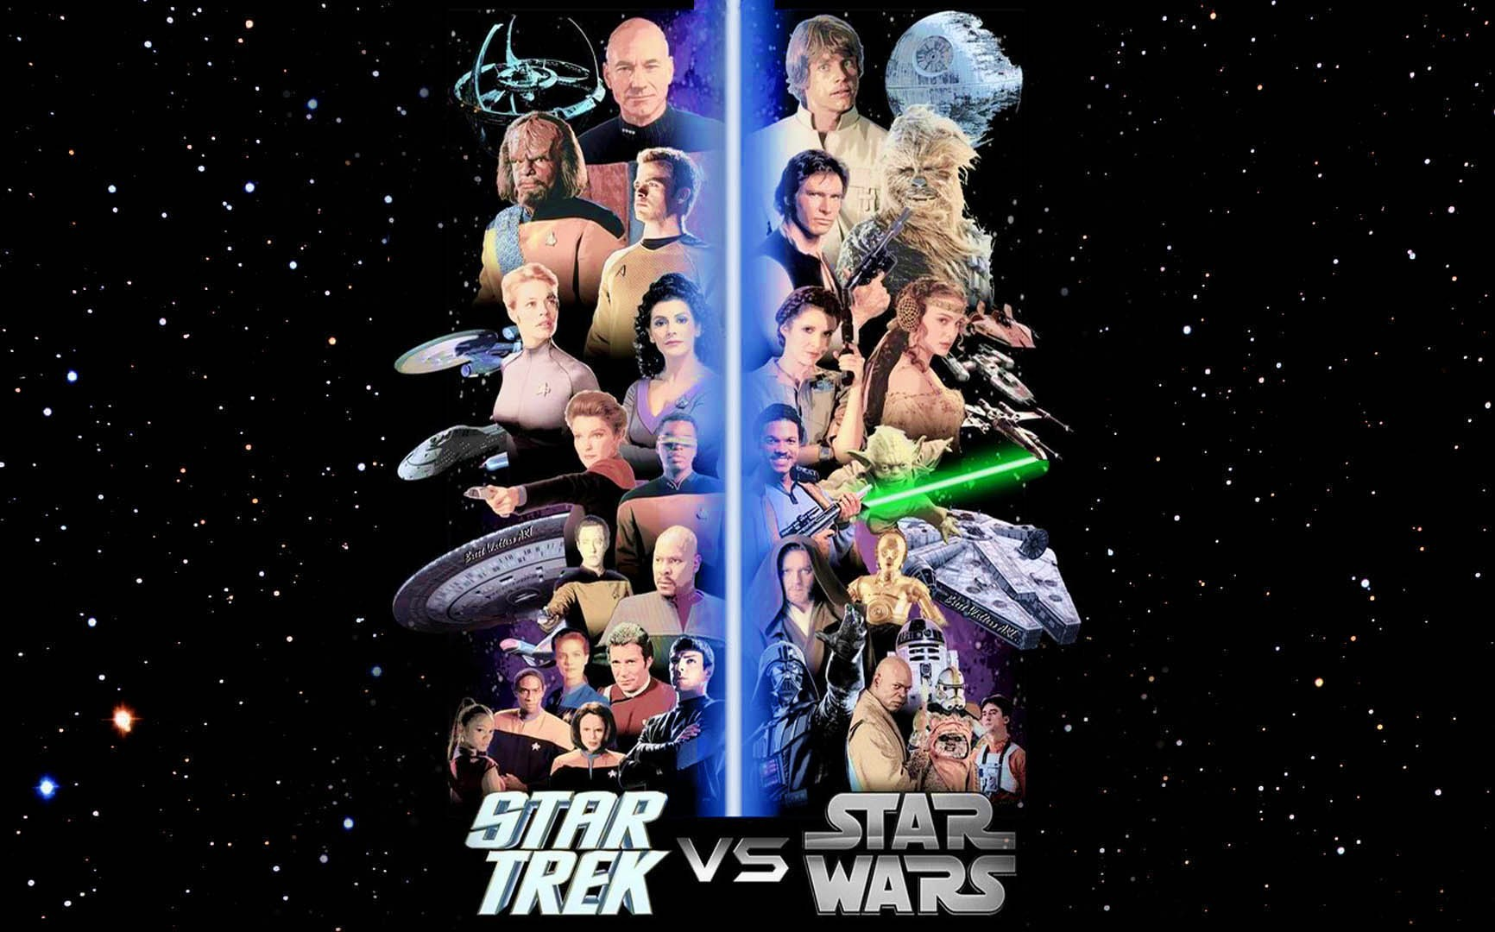
Episode II:
Assertions

Slide 32
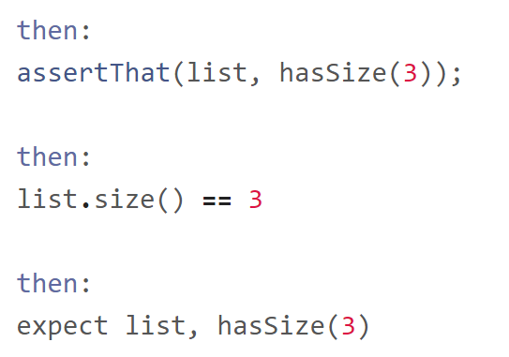
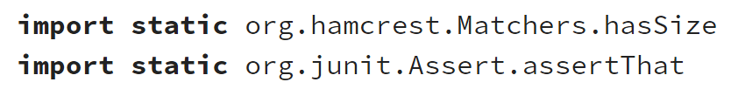
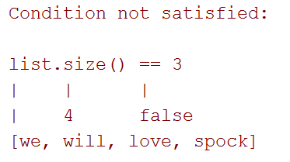
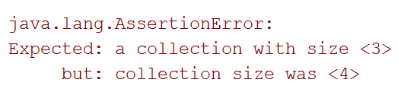
Episode II: Assertions

Slide 33
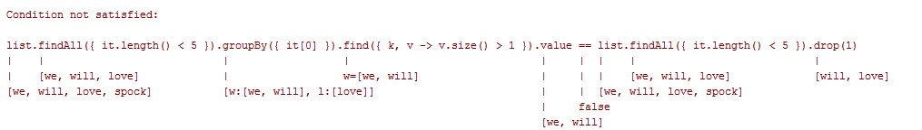
Episode II: Assertions

Slide 34
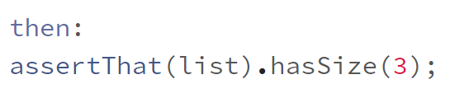
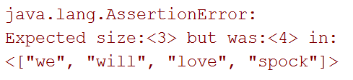
Episode II: Assertions

Slide 35
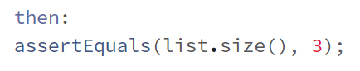
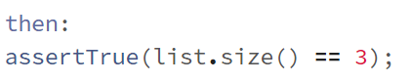
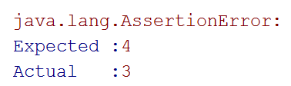
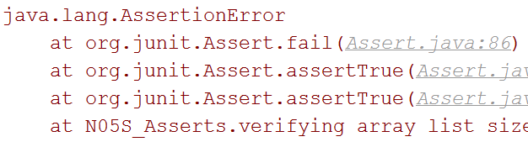
Episode II: Assertions

Slide 36
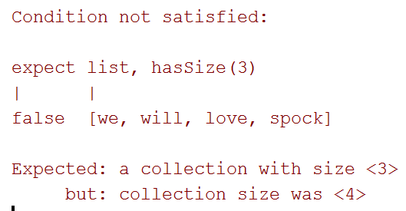
Episode II: Assertions

Slide 37
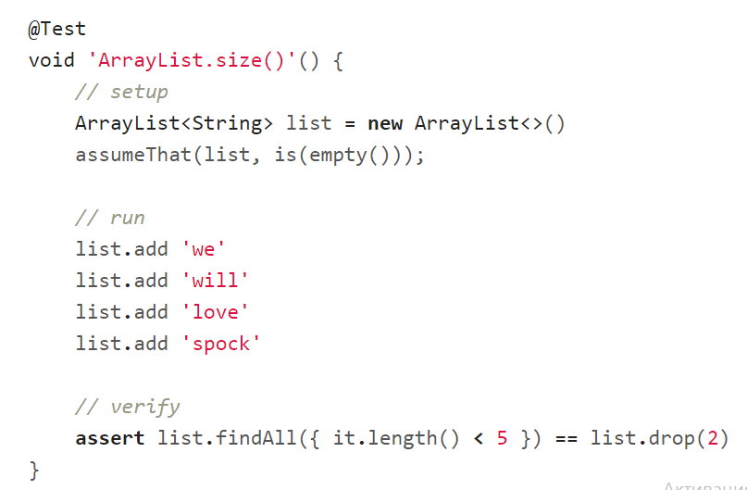
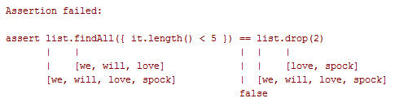
Episode II: Assertions

Slide 38
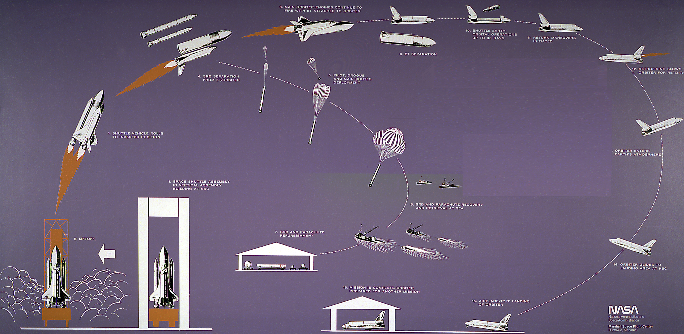
Episode III:
Test structure

Slide 39
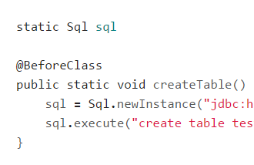
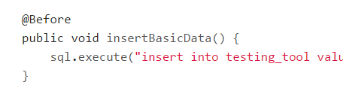
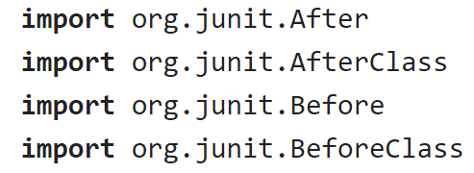
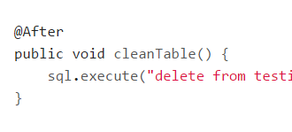
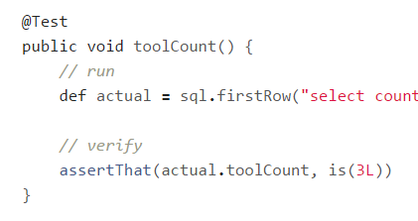
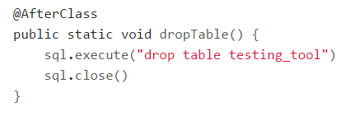
Episode III: Test structure

Slide 40
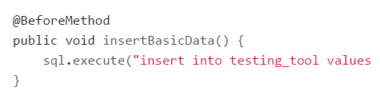
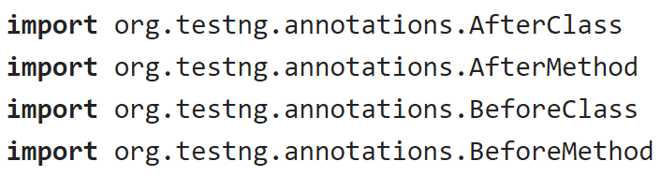
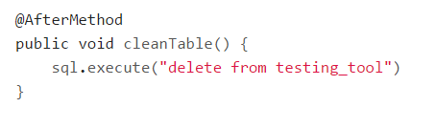
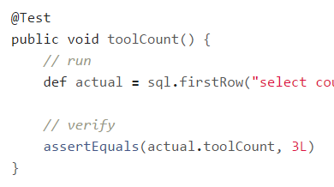
Episode III: Test structure

Slide 41
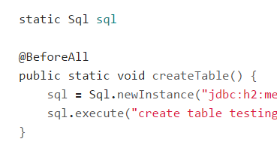
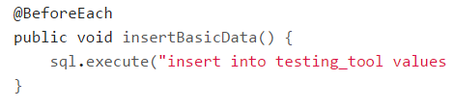
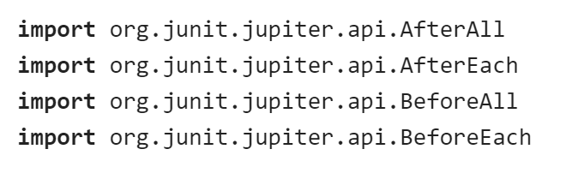
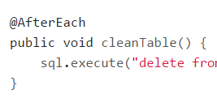
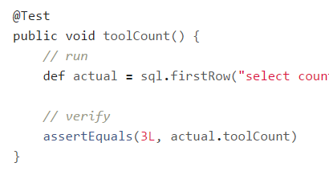
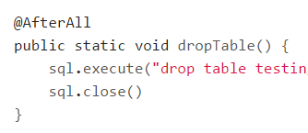
Episode III: Test structure

Slide 42
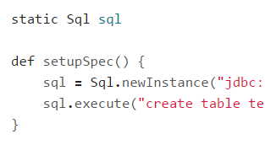




Episode III: Test structure

Slide 43


Episode III: Test structure

Slide 44

Episode III: Test structure

Slide 45


Episode III: Test structure

Slide 46

Episode III:
Test structure

Slide 47

Episode III:
Test structure
github.com/renatoathaydes/spock-reports

Slide 48

Episode IV:
Data driven test

Slide 49

Episode IV: Data driven test

Slide 50

Episode IV: Data driven test

Slide 51

Episode IV: Data driven test

Slide 52

Episode IV: Data driven test

Slide 53

Episode IV: Data driven test

Slide 54

Episode IV: Data driven test

Slide 55

Episode IV: Data driven test

Slide 56

Episode IV: Data driven test

Slide 57


Episode IV: Data driven test

Slide 58

Episode VI:
Exceptions

Slide 59

Episode VI: Exceptions

Slide 60

Episode VI: Exceptions

Slide 61

Episode VI: Exceptions

Slide 62

Episode VI: Exceptions

Slide 63

Episode VI: Exceptions

Slide 64

Episode VI: Exceptions

Slide 65

Episode VI: Exceptions

Slide 66

Episode VI: Exceptions

Slide 67

Episode VI: Exceptions

Slide 68

Episode VII:
Mocks,
Stubs,
Spies

Slide 69


Episode VII: Mocks, Stubs, Spies

Slide 70

Episode VII: Mocks, Stubs, Spies

Slide 71


Episode VII: Mocks, Stubs, Spies

Slide 72

Episode VII: Mocks, Stubs, Spies

Slide 73

Episode VII: Mocks, Stubs, Spies

Slide 74


Episode VII: Mocks, Stubs, Spies

Slide 75

Episode VII: Mocks, Stubs, Spies

Slide 76

Episode VII: Mocks, Stubs, Spies

Slide 77

Episode VII: Mocks, Stubs, Spies

Slide 78

Episode VII: Mocks, Stubs, Spies

Slide 79

Episode VIII: Time travel

Slide 80

Episode VIII: Time travel

Slide 81
Episode VIII: Time travel

Slide 82


Episode VIII: Time travel

Slide 83

Episode VIII: Time travel

Slide 84

Episode VIII: Time travel

Slide 85

Episode VIII: Time travel

Slide 86

Episode VIII: Time travel

Slide 87


Episode VIII: Time travel

Slide 88

Episode VIII: Time travel

Slide 89


Episode VIII: Time travel

Slide 90

Episode IX:
Test control

Slide 91



Episode IX: Test control

Slide 92

Episode IX: Test control

Slide 93
Episode IX: Test control

Slide 94

Episode IX: Test control

Slide 95

Episode IX: Test control

Slide 96

Episode IX: Test control

Slide 97

Episode IX: Test control

Slide 98

Episode IX: Test control

Slide 99

Episode IX: Test control

Slide 100


Episode IX: Test control

Slide 101

Episode IX: Test control

Slide 102



Episode IX: Test control

Slide 103

Episode X: Encore

Slide 104

Episode X: Encore

Slide 105

Episode X: Encore

Slide 106

Episode X: Encore

Slide 107

Episode X: Encore

Slide 108

Episode X: Encore

Slide 109

Episode X: Encore

Slide 110

Episode X: Encore

Slide 111

Why one should use Spock?

Slide 112

Concise syntax

Slide 113

Language for testing instead of testing struggling language

Slide 114

Clear test structure

Slide 115

Code and reports readable for everyone

Slide 116

Powerful built-in features

Slide 117

Extensions

Slide 118

Useful for unit, integration and functional tests

Slide 119


Behaves as one more JUnit runner

Slide 120

Works for both Groovy and Java

Slide 121

Why one should not use Spock?

Slide 122

JUnit/TestNG has 90% similar/imitable features

Slide 123



Spock lost its lead developer

Slide 124

When one can use Spock?

Slide 125

Your team is ready to make one step forward

Slide 126

You are about to start new project

Slide 127

You want to cover legacy project with unit tests

Slide 128

You want to introduce functional testing in your project

Slide 129
What’s next?
Spock documentation
Spock source repositories
Spock examples project
Spock smoke tests
Spock Web Console
Spock reports

Slide 130
What’s next?
mrhaki about Spock
Spock vs JUnit by Kostis Kapelonis and Athens Greece
Smarter testing Java code with Spock Framework by Marcin Zajączkowski
Idiomatic Spock by Rob Fletcher
Spock: A Logical Framework for Enterprise Testing by Ken Kousen

Slide 131
What’s next?
Java Testing with Spock by Konstantinos Kapelonis
Geb documentation
Geb for browser automation by Jacob Aae Mikkelsen
https://twitter.com/yermilov17
https://www.facebook.com/yaroslav.yermilov
https://ua.linkedin.com/pub/yaroslav-yermilov/58/682/506

Slide 132

Thanks!

